Slide 1





Call Center Performance Analysis Analysis of call center
Name : Aravind Bhumagani
Contact : 8184872014

Slide 2
Task 1: Data Exploration
Summary Statistics :
Amount TimeDuration
count 9016.0000 21398.0000
mean 23.742890 1.977168
std 87.134998 3.340467
min 0.000000 -0.166667
Max 1800 67.000
Total Earnings and Spending: Users' spending and masters' earnings highlight the revenue flow. Ensuring a balance between user charges and masters' earnings is crucial for sustainable growth.

Slide 3
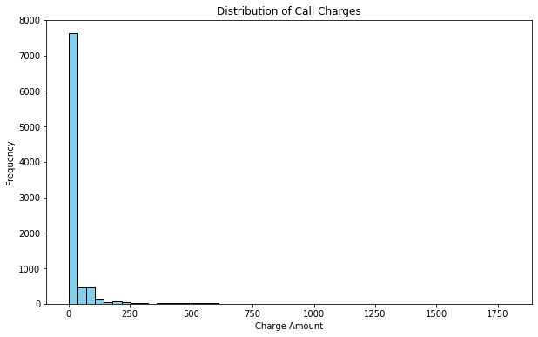
Histogram of Call Charges:
Most calls are low or no charge, with a few high-charge calls. Indicates many short or free calls, with a right-skewed distribution.
Average TalkTime: Different call activities have varying average TalkTimes. Some activities might require more attention and time.

Slide 4
Task 2: Call Center Performance Metrics
Average TalkTime for Different Call Activities Activity :
Average TalkTime
Call 1.979025
Chat 1.975428
Complementary 5.000000
public_live_Call 2.529850
The most common source of calls is: Production
Total Earnings and Spending Total earnings for users: 214065.89866666665
Total spending for masters: 99146.57095000001
Highest Earning
User: gid 19
GuruName : Dr Balkrisna
Amount : 1800.0
ConsultationType : Call
TimeDuration : 30.0
The correlation between TalkTime and Charge is: 0.6522799350153664 (GOOD)
Relationship Between TalkTime and Charge:
A positive correlation was found between TalkTime and Charge, indicating that longer calls result in higher charges.

Slide 5
Task 3: Call Handling Analysis Average Connection Time
(connectTime or dialTime column is missing.)
HangUpTime Patterns
user 6
astro_system 1
user_system 1
astrologer 1
Total calls based on astrologerCallStatus
completed 9172
no-answer 5367
busy 1342
failed 377
HangUpTime Patterns: Analyzing HangUpTime patterns revealed peak hours, which can help in resource planning and managing call center load effectively.

Slide 6
Order Status Distribution :
orderStatus column is missing.
Total Refund Amount and Refund Status Distribution :
Total refund amount: 214065.89866666665
no-refund 28022
Approved 3
Rejected 1
Processing 1
Task 4: Order and Refund Analysis
Total Refund Amount: Keeping track of the refund amount and reasons for refunds helps improve service quality and user satisfaction

Slide 7
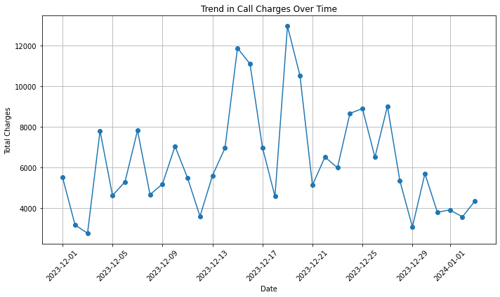
Line Chart of Call Charges Over Time:
Identifying Peak Times: By analyzing the dates with the highest charges, we can identify peak times. This information can be used to allocate more resources during these periods to handle the increased demand.

Slide 8
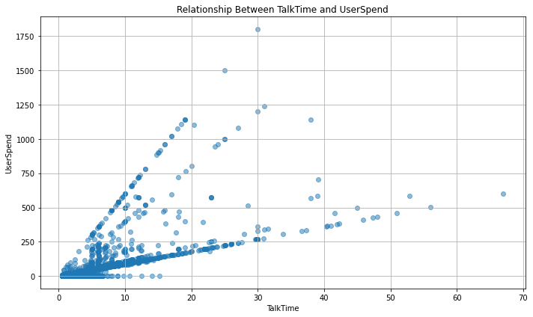
Scatter Plot of TalkTime and UserSpend:
Generally, shows a positive correlation, indicating longer calls lead to higher charges. Presence of outliers could suggest special cases or data inconsistencies. Variability in charges for similar TalkTime durations highlights potential promotional impacts.

Slide 9
Insights and Recommendations :
Reduce Connection Time:
Insight: The average time to connect is a critical metric for user satisfaction.
Recommendation:
Invest in better call routing and connectivity infrastructure to reduce the average connection time.
Implement a priority system for high-value users to ensure quick connections.
Improve Call Disconnection Handling:
Insight: The most common reason for call disconnection should be addressed.
Recommendation:
Provide training for users and masters on how to avoid common disconnection reasons.
Implement a system to quickly reconnect disconnected calls to improve user experience.

Slide 10
Optimize Resource Allocation During Peak Hours:
Insight: HangUpTime patterns reveal peak hours.
Recommendation: Ensure adequate staffing and resources during peak hours to handle the higher call volume efficiently. Use historical data to predict and prepare for peak periods.
Enhance User and Master Experience:
Insight: A positive correlation between TalkTime and Charge indicates that users are willing to pay for valuable consultations.
Recommendation: Provide additional training for masters to enhance their service quality, ensuring that users feel their time and money are well spent. Introduce loyalty programs for frequent users to increase satisfaction and retention.

Slide 11
Monitor and Improve Order Completion Rates:
Insight: Understanding why some orders are not completed can highlight areas for improvement.
Recommendation: Analyze incomplete or canceled orders to identify common issues. Implement measures to address these issues, such as clearer instructions, better user interfaces, and improved support.
Targeted Marketing and User Acquisition:
Insight: Knowing the most common sources of calls helps in targeting marketing efforts.
Recommendation: Focus marketing efforts on the most effective channels. Use data-driven insights to refine user acquisition strategies and optimize marketing

